Slide 1
+
BEYOND REINFORCEMENT LEARNING: MeTTa-NARS & NACE
MAY 2024

Slide 2
I. MeTTa-NARS

Slide 3
INTRODUCTION
Implementation of NARS in MeTTa language
A general-purpose reasoning system proposed by Dr. Wang
Follows NARS model of intelligence and design paradigms
Non-Axiomatic Logic (NAL): term logic with Uncertainty Estimation
Real-time learning
Operation under Assumption of Insufficient Knowledge and Resources (AIKR):
Finite processing demands
Open to new information at runtime
Real-time operation

Slide 4
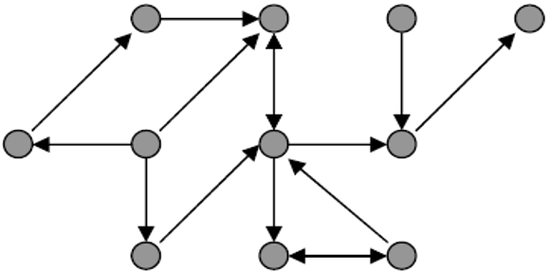
MODULAR STRUCTURE
Distinctive and efficient structure
Modular Design
Practical approach
Easy to integrate and support
Reasoner components:
Logic
Memory
Control
NAL 1-5
TruthFunctions
Logic.metta
Reductions
MeTTa-NARS
Memory.metta
Events
Concepts
Control.metta
Declarative
Temporal
Procedural

Slide 5
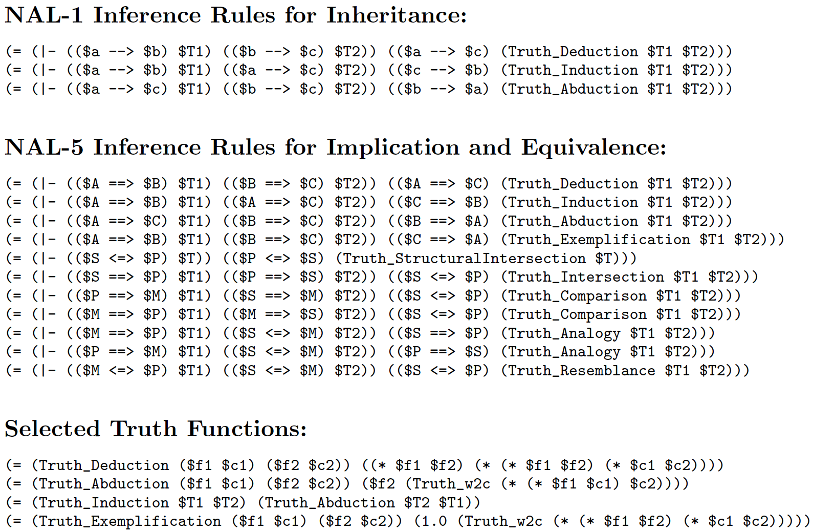
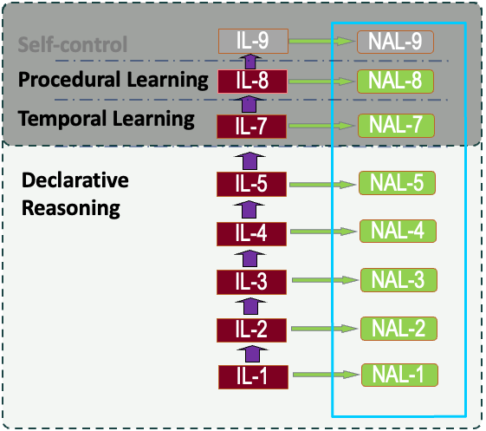
THE LOGIC

Slide 6
ARCHITECHTURE
Reasoning Node
Learn from event streams in real time, without interruption
Extract sensorimotor contingencies
Use them to plan ahead to reach goals
Enhance autonomy of intelligent agents
Declarative Inference
Concept Memory
Priority Queues
Attentional Focus
(Concepts)
Long Term
(Concepts)
Event Providers
Beliefs
Goals
Temporal Inference
Procedural Inference

Slide 7
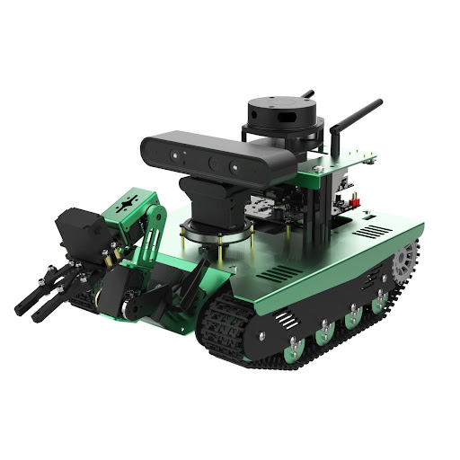
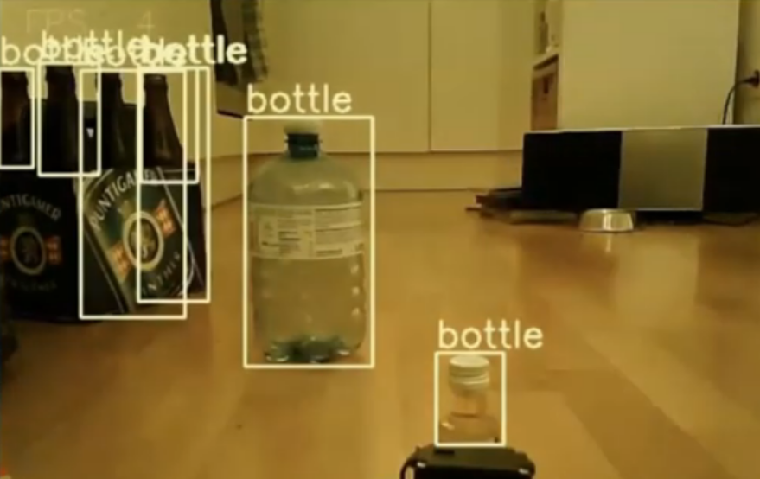
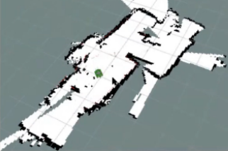
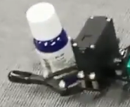
TRANSBOT & NARS
Vision (YOLO v4)
RGB cam
Distance
Infrared cam
Localization
LIDAR & GPS
Touch
Servo
Lidar
Depth camera
RGB cam
RGB cam
Mic
Robotic
arm
GPS
NARS Reasoner
Servo
Sensor
^left/^right/
^forward
^goto
^pick/^drop

Slide 8
THE DEMO …
Garbage collection
Navigate real-world environment
Pick garbage with manipulator
Essential components
Object recognition via YOLOv4
Simultaneous Localization and Mapping
NARS real-time reasoning and learning is responsible for decision making

Slide 9
II. NACE (Non-Axiomatic Causal Explorer)

Slide 10
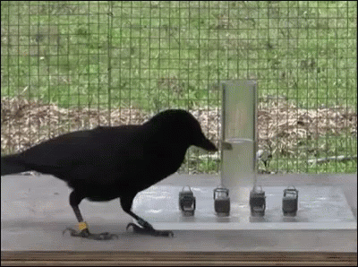
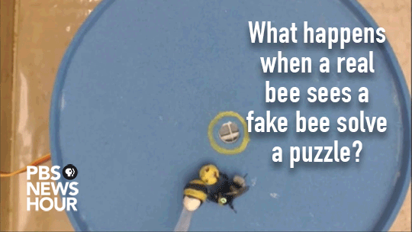
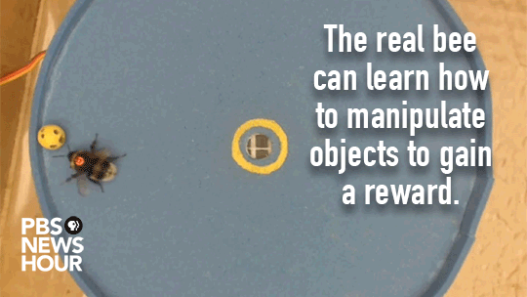
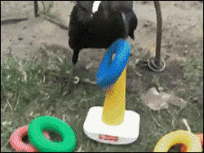
CAUSAL REASONING IN NATURE…
Evidence for causal reasoning between species varies
Corvids, dolphins, elephants, great apes:
long-horizon planning abilities with profound
causal knowledge and ability to acquire new one
Bumblebee: too early to say, maybe “just” a form of imitation learning?

Slide 11
INTRODUCTION
Experiential Learning
Learning from observation
Incremental and interactive learning
No high-level semantic encoding
Main Features
Utilizes logical causal relation induction from observation using NAL aspects
Causal relations capturing transitions between parts of states, not full transitions between states
Planning for future states of maximum uncertainty for data-efficient exploration

Slide 12
INDUCTIVE BIASES
Temporal Locality
Ability to model relevant dependencies locally in time, in simplest case just involving prior simulation frame.
Causal Representation
Ability to model causal dependencies independently of acquired reward, making the model able to learn beliefs of the environment that are agnostic to its objective.
Spatial Equivariance
Ability to model causal dependencies between grid cells independently of the specific location of the cells considered in the dependency.
State Tracking
Ability to effectively track state outside of the field of view of the agent based on the recorded or estimated locations.
Attentional Bias
Relevant dependencies tend to involve values that have either changed or a different value than predicted (miss-matched)

Slide 13
ARCHITECHTURE
Explorer 1
Data efficient Rule Learning
Driven by curiosity and uncertainty
No encoding of high-level semantic knowledge
Changing cells with learned operation over time
Iterative emerging behavior
Creates structures to allow more robust and efficient procedural learning
Observer
Registers changes
Finds mismatches
Actual World
Rule Engine
Creation
Revision
Choice
Planner
Score incr.
${min(P}_{w})<1$
Babbling
Predictor
Calcs $P$-match
Creates Imaginary Worlds
Makes Predictions

Slide 14
P-MATCH FOR CURIOSITY AND EXLORATION
Rule P-match of certain cell:
$$P_{r}^{c}= \frac{matched conditions}{total conditions}$$
Cell P-match:
$$P_{c}=\max\left(P_{r}^{c 1}…P_{r}^{c n}\right)$$
World P-match:
$$P_{w}=max⁡(P_{c}^{1,1}…P_{c}^{n,m})$$
Planner selection criteria:
$$P_{w}=\min\left(P_{w}^{1}…P_{w}^{n}\right)$$
$$P_{w}<1$$

Slide 15
SHORT DEMO
Operations:
Actual World
Explorer 1
||| | ||| | ||| | ||| | ||| | ||| | |||
||| |  |  |  |  |  | |||
||| |  | X |  |  |  | |||
||| | ||| | ||| | ||| | ||| | ||| | |||
Observer
Registers changes
Finds mismatches
Rules:
$w^{+}w^{−}w^{T}$
R1: <(0 = ‘x’, 1 = ‘’, ^right) ==> (0 = ‘’)> 1 0 1
R2: <(-1 = ‘x’, 0 = ‘’, ^right)==> (0 = ‘x’)> 1 0 1
…
Rule Engine
Creation
Revision
Choice
Imaginary Worlds:
Mental World
||| | ||| | ||| | ||| | ||| | ||| | |||
||| |  |  |  |  |  | |||
||| | X | X |  |  |  | |||
||| | ||| | ||| | ||| | ||| | ||| | |||
1’ | 1’ | 1’ | 1’ | 1’ | 1’ | 1’
1’ | 1’ | 1’ | 1’ | 1’ | 1’ | 1’
1’ | 1’ | 1’ | 1’ | 1’ | 1’ | 1’
1’ | 1’ | 1’ | 1’ | 1’ | 1’ | 1’
1’ | 1’ | 1’ | 1’ | 1’ | 1’ | 1’
0.5 | 0.5 | 0.5 | 0.5 | 0.5 | 0.5 | 1’
0.5 | 0.5 | 1, ‘’ | 1, X | 0.5 | 0.5 | 1’
1’ | 1’ | 1’ | 1’ | 1’ | 1’ | 1’
Planner
Score incr.
$P_{w}<1$
Babbling
…
Predicted World ($P_{w}<1$)
1’ | 1’ | 1’ | 1’ | 1’ | 1’ | 1’
1’ | 1’ | 1’ | 1’ | 1’ | 1’ | 1’
1’ | 1’ | 1’ | 1’ | 1’ | 1’ | 1’
1’ | 1’ | 1’ | 1’ | 1’ | 1’ | 1’
1’ | 1’ | 1’ | 1’ | 1’ | 1’ | 1’
0.5 | 0.5 | 0.5 | 0.5 | 0.5 | 0.5 | 1’
0.5 | 0.5 | 0.5 | 1, ‘’ | 1, X | 0.5 | 1’
1’ | 1’ | 1’ | 1’ | 1’ | 1’ | 1’
||| | ||| | ||| | ||| | ||| | ||| | |||
||| |  |  |  |  |  | |||
||| |  |  | X |  |  | |||
||| | ||| | ||| | ||| | ||| | ||| | |||
…
Predictor
Calcs $P$-match
Creates Imaginary Worlds
Makes Predictions
1’ | 1’ | 1’ | 1’ | 1’ | 1’ | 1’
1’ | 1’ | 1’ | 1’ | 1’ | 1’ | 1’
1’ | 1’ | 1’ | 1’ | 1’ | 1’ | 1’
1’ | 1’ | 1’ | 1’ | 1’ | 1’ | 1’
1’ | 1’ | 1’ | 1’ | 1’ | 1’ | 1’
0.5 | 0.5 | 0.5 | 0.5 | 0.5 | 0.5 | 1’
0.5 | 0.5 | 0.5 | 0.5 | 1, ‘’ | 1, X | 1’
1’ | 1’ | 1’ | 1’ | 1’ | 1’ | 1’
…
1’ | 1’ | 1’ | 1’ | 1’ | 1’ | 1’
1’ | 1’ | 1’ | 1’ | 1’ | 1’ | 1’
1’ | 1’ | 1’ | 1’ | 1’ | 1’ | 1’
1’ | 1’ | 1’ | 1’ | 1’ | 1’ | 1’
1’ | 1’ | 1’ | 1’ | 1’ | 1’ | 1’
0.5 | 0.5 | 0.5 | 0.5 | 0.5 | 0.5 | 1’
0.5 | 0.5 | 0.5 | 0.5 | 0.5 | 0.5 | 1’
1’ | 1’ | 1’ | 1’ | 1’ | 1’ | 1’

Slide 16
UNCERTAINTY ESTIMATION
Revision
Collects the $w^{+}$ and $w^{−}$evidence experienced so far
Revises rules which allowed for valid prediction and/or mismatch
Choice
Makes certain rules invisible for the planner
Given rules with same pre-conditions selects the highest truth expectation
$w^{+}w^{−}w^{T}$
R1: <(0 = ‘x’, 1 = ‘’, ^right) ==> (0 = ‘’)> 2 1 3
R2: <(-1 = ‘x’, 0 = ‘’, ^right) ==> (0 = ‘x’)> 2 1 3
R3: <(0 = ‘x’, 1 = ‘|||’, ^right) ==> (0 = ‘x’)> 1 0 1
R4: <(-1 = ‘x’, 0 = ‘|||’, ^right) ==> (0 = ‘|||’)> 1 0 1
R5: <(0 = ‘x’, 1 = ‘’, ^right) ==> (0 = ‘x’)> 1 0 1
R6: <(-1 = ‘x’, 0 = ‘’, ^right) ==> (0 = ‘’)> 1 0 1

Slide 17
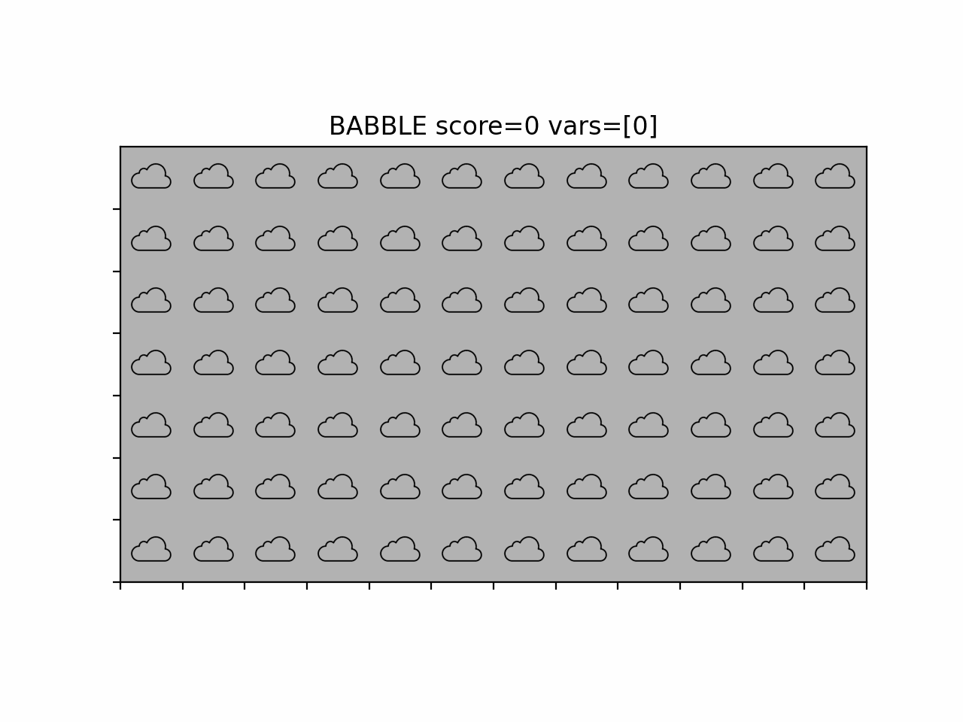
REAL-TIME SINGLE-EPISODE LEARNING DEMO

Slide 18
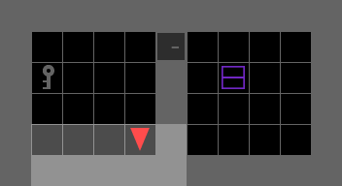
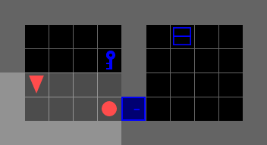
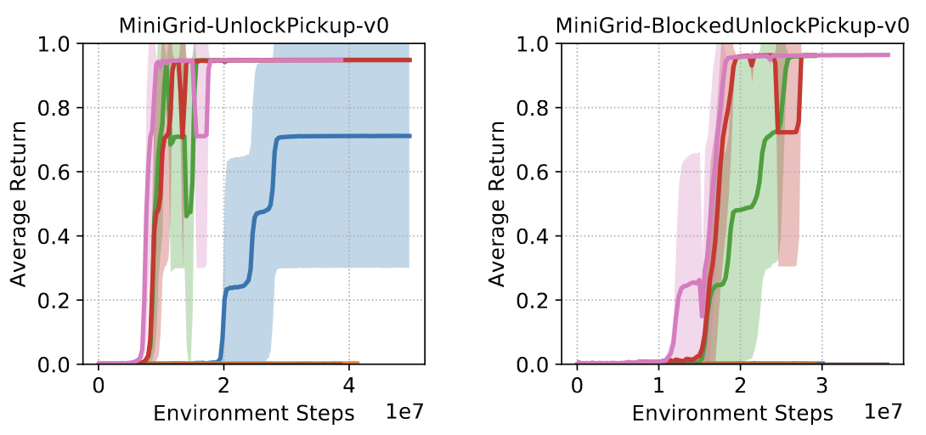
QUANTATIVE RESULTS IN MINIGRID (Gym-Minigrid)
MiniGrid-UnlockPickup | SOTA methods | Explorer
Learning steps till avg. return > 0.9 | 10 Million | 110
MiniGrid-BlockedUnlockPickup-v0 | SOTA methods | Explorer
Learning steps till avg. return > 0.9 | 15 Million | 160

Slide 19
THANK YOU!

