Slide 1
Causal Exploration with Experiential Reasoning and Learning Systems
IAGI 2024
Patrick Hammer
with special thanks to:
Robert Johansson
Tony Lofthouse
Peter Isaev
Pei Wang

Slide 2
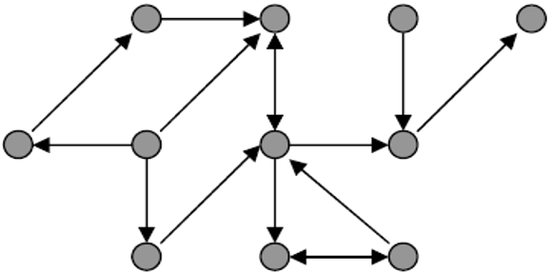
THE TABLE
OF CONTENT
1. Intelligence, Reasoning and Learning
2. Non-Axiomatic Reasoner (NARS) and ONA
3. Comparison with RL, relational conditioning
4. NARS on mobile robots and experiments
5. Causal reasoning & curiosity in grid worlds
6. Conclusion

Slide 3
Intelligence,
Reasoning and Learning

Slide 4
THE LADDER OF INTELLIGENCE
Humans
(language)
Mammals, Birds
(reasoning)
Insects
(adaptation)
Self-driving cars
(pre-trained, pre-programmed,
automation)
Coffee machines
(pre-programmed, automation)

Slide 5
Intelligence
Assumption of Insufficient Knowledge (AIKR):
With sufficient knowledge and resources any problem is solvable. Covering all relevant cases and having sufficient time to process is seldomly possible in the real world!
Definition of Intelligence:
According to NARS Team: intelligence is the ability to adapt under insufficient knowledge and resource (AIKR). Intelligent species in nature: adapt quickly, repeating mistakes is often fatal or survival-relevant!

Slide 6
Reasoning and Learning
Reasoning:
A model of logically justifiable thought patterns which results typically can be chained together -> A model of thinking? A way to build effective experiential learning systems?
and Learning:
Reasoning can also account for learning which demands forms of inductive reasoning and belief revision
from experience:
an open-ended never-ending process that affects, and is driven by, the observations, beliefs and goals of the agent

Slide 7
Non-Axiomatic Reasoning System
and ONA implementation

Slide 8
Non-Axiomatic Reasoning System (NARS)
A general-purpose reasoning system proposed by Dr. Wang
Operates under Assumption of Insufficient Knowledge and Resources:
Finite processing demands
Open to new information at runtime
Real-time operation
Uses Non-Axiomatic Logic (NAL):
a term logic able to deal with uncertainty

Slide 9
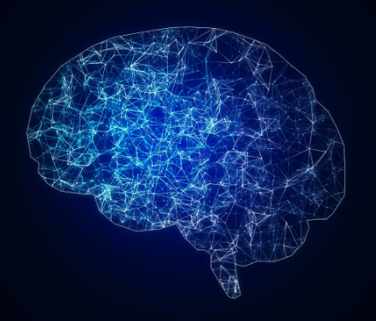
Non-Axiomatic Logic (NAL)
Terms:
atomic (such as cat, animal) or compound
Statements in NAL: (compounds with logical copulas)
Inheritance <cat → animal>, <{garfield} → animal>,
<cat → [meowing]>
Implication <lightning ⇒ thunder>
Nested <<switch → [on]> ⇒ <light → [on]>>
Procedural: <(<switch → [off]> &/ ^activate) ⇒ <switch → [on]>>
Truth Value in NAL:
Positive w+ and negative evidence w-
Frequency: w+ / (w+ + w-)
Confidence: w / (w + 1) with w := w+ + w-

Slide 10
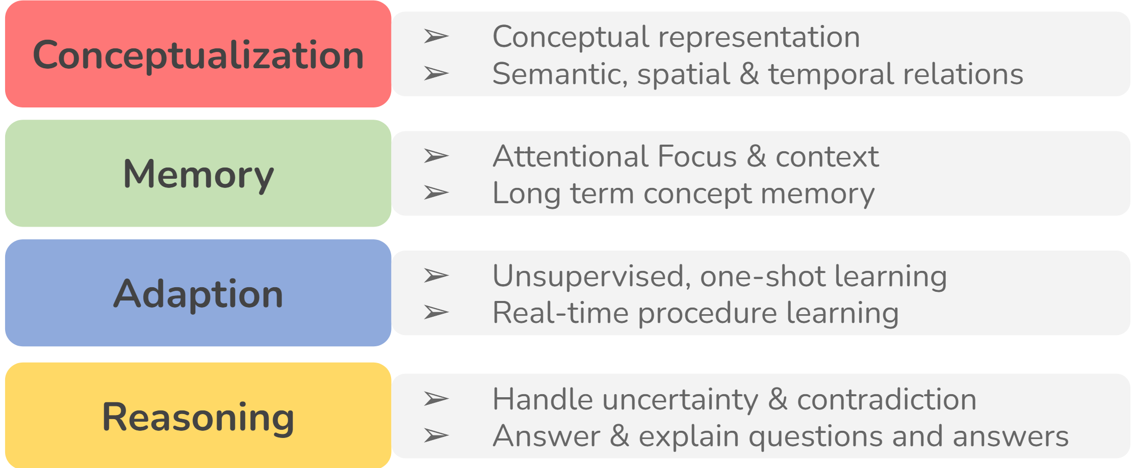
NARS CAPABILITIES

Slide 11
OpenNARS for Applications (ONA)
A pragmatic design following NARS theory
General-purpose reasoning system utilizing NAL
Provides cumulative real-time learning
Designed for reaching goals, establishing sub-goals and proceed with planning
Capable of controlling intelligent agents including robots for enhanced autonomy
Supports interfacing with state-of-the-art Deep Learning models

Slide 12
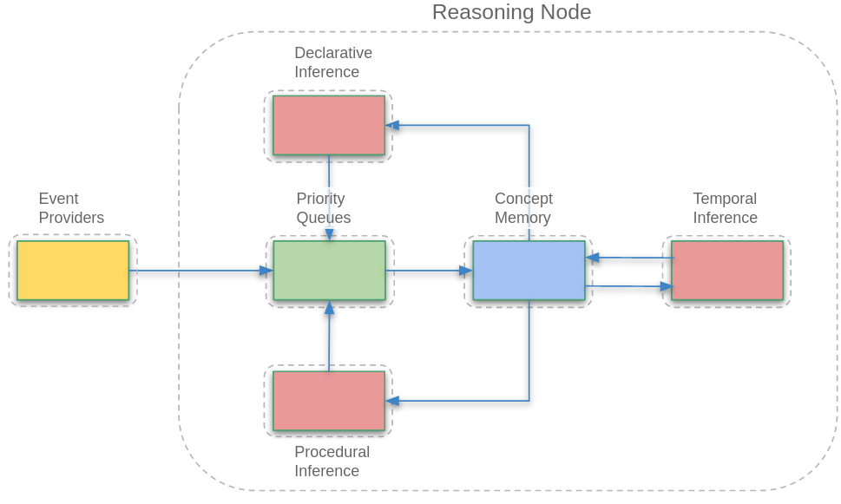
ONA architecture
Learn from event streams in real time, without interruption
Extract sensorimotor contingencies
Use them to plan ahead to reach goals
Enhance autonomy of intelligent agents

Slide 13
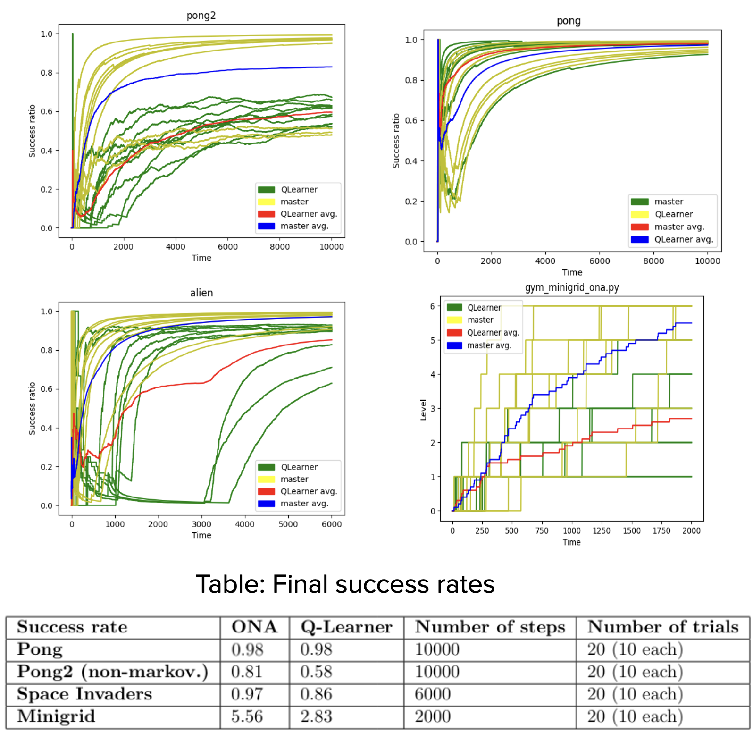
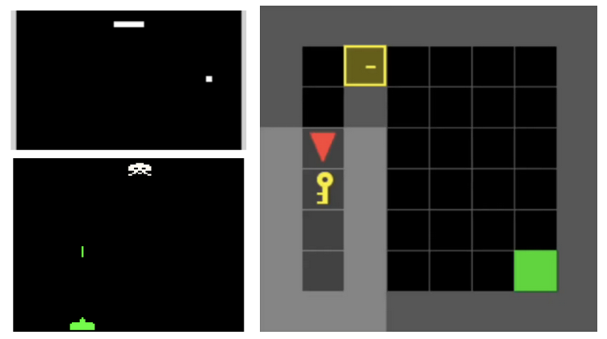
NARS vs. RL
NARS is a viable alternative for classical RL tasks
Performs better when RL assumptions are violated (changing utility function, non-markovian environments)
And delivers better knowledge transfer

Slide 14
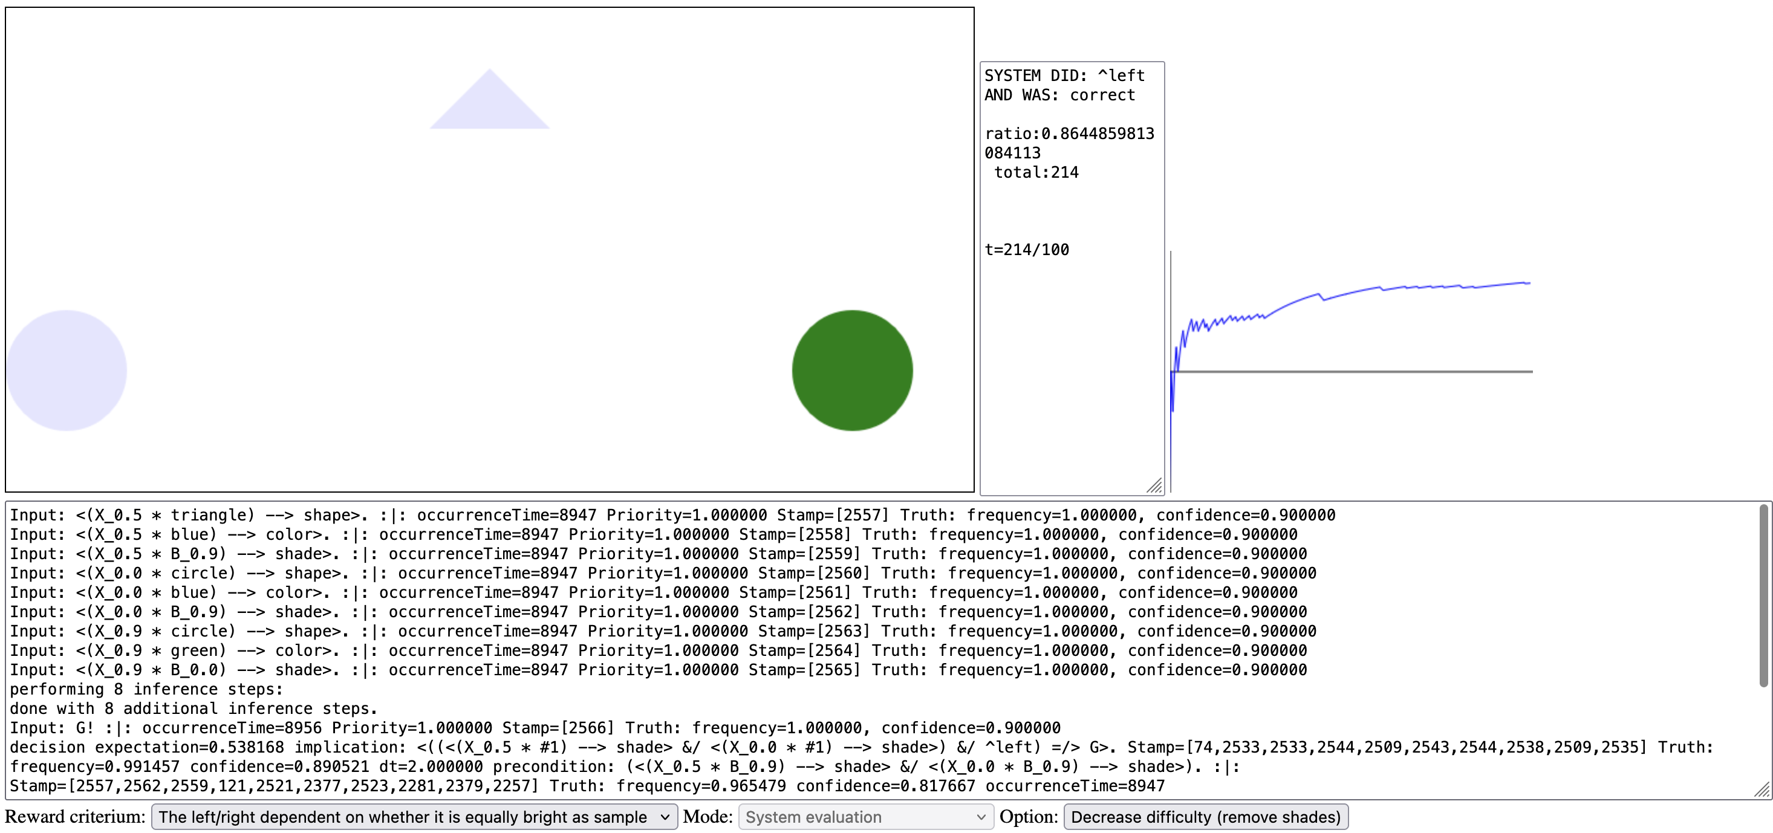
Shape picking competition
NARS learns to select shape based on shape, color, position, shade
Try yourself: http://91.203.212.130/AniNAL/demo_complex_shades.html

Slide 15
NARS on mobile robots

Slide 16
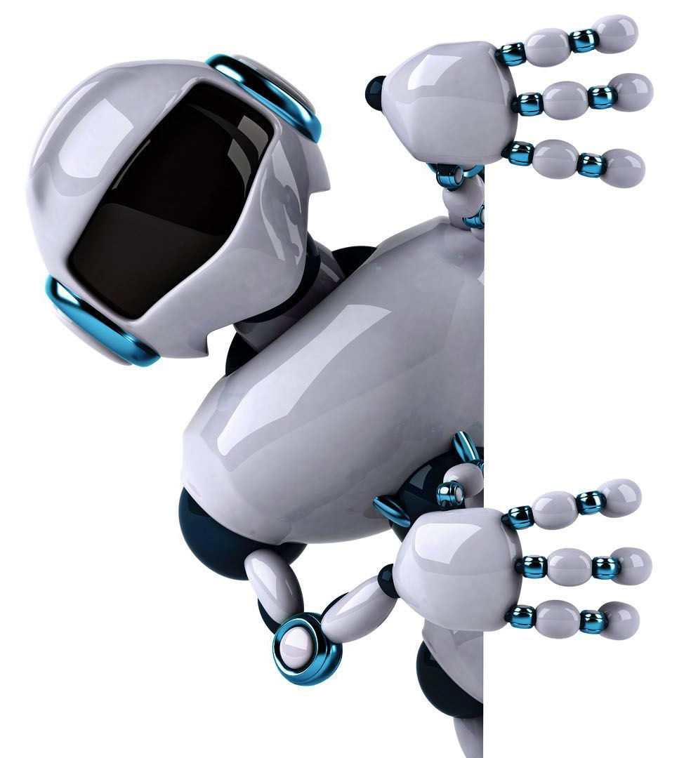
FEATURES
Can act as central decision making unit for mobile robots with multiple sensors types and attached actuators for manipulation
NARS’s multimodal capability allows for effective and efficient real-time processing of sensor data from multiple modalities
Data-efficient real-time learning with uncertainty handling and ability to take user-given logical knowledge into account
NARS’s memory capacity is always fixed to a constant and memory consumption is strictly constrained
Applicable on strictly memory-constrained hardware where a memory consumption bound guarantee is essential.

Slide 17
MOTIVATION
Adaptation of mobile robots to unforeseen disturbances at runtime remains a challenge
Online learning is heavily restricted to the content (what can be learned), and speed (data-efficiency of learning non-trivial tasks)
Integrate Non-Axiomatic Reasoning System (NARS) into robots and facilitate real-time learning and uncertainty handling for robustness and adaptability to different tasks!
Allow NARS to utilize ROS components such as SLAM and the navigation stack for movement
Allow to use SOTA Deep Learning models for perceptual processing while making use of on-board GPU hardware

Slide 18
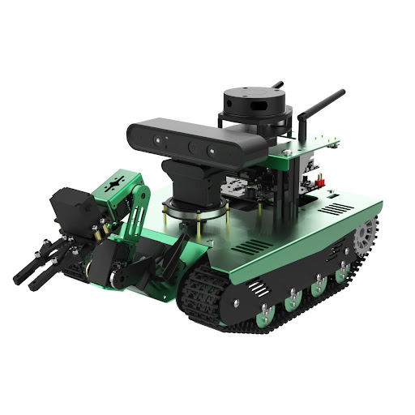
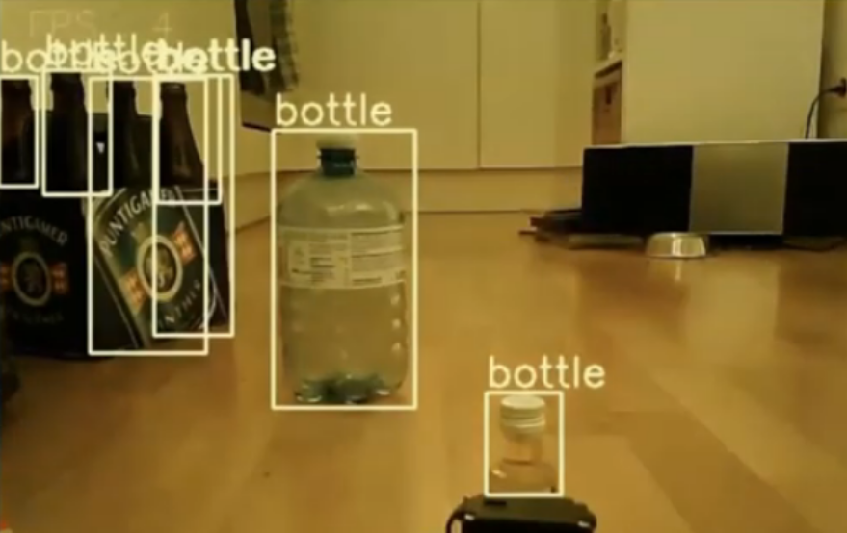
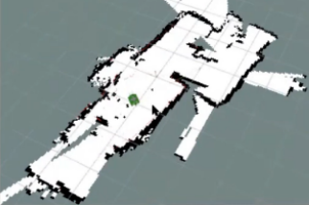
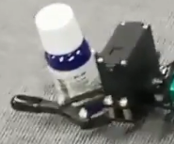
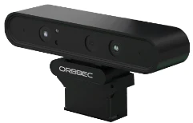
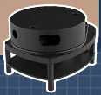
TRANSBOT & NARS
Vision (YOLO v4)
RGB cam
Distance
Infrared cam
Localization
LIDAR & GPS
Touch
Servo
Lidar
Depth camera
RGB cam
RGB cam
Mic
Robotic
arm
GPS
NARS Reasoner
Servo
Sensor
^left/^right/
^forward
^goto
^pick/^drop

Slide 19
CAPABILITIES
Builds a map of environment using Lidar scans via SLAM
Detects objects in camera input via ConvNet (YOLOv4)
Remembers already observed objects and their location (NARS)
Moves to the location avoiding obstacles (ROS navigation stack)
Visual & servo feedback for grasping (Multi-modal feedback control)
Ability to manage mission progress: invoking high-level decisions, adapting to failures by combining existing and newly learned knowledge.
All of the above: Finds and collects objects with user-specified properties

Slide 20
VISION & DEPTH
Uses YOLOv4 to work with real-time camera data
Uses label with softmax probability as frequency, width, height, color summary within BB for (R, G, B) values describing the detected object
Treat positionX, positionY extra to build spatial relations among objects
Encoded as <bottle --> [location]> events for NARS
Additional gripper feedback encoded as <gripper --> [holding]>
InfraRed depth sensor to read distance to objects within 0.6 - 8 meters

Slide 21
EXPERIMENT

Slide 22
THE MISSION
Garbage collection
Navigate real-world environment
Pick garbage with manipulator
Essential components
Object recognition via YOLOv4
Simultaneous Localization and Mapping
NARS real-time reasoning and learning component (our ongoing work), responsible for decision making

Slide 23
TEST PROCEDURE
The robot was positioned at a starting point within the testbed and sent on an initial control route to generate the initial map
Bottles and cups of different sizes (10 objects) and materials (plastic, paper and glass) were placed at the checkpoints in upright position, and the success rate in object detection and manipulator control was recorded during the mission.
The reasoner is given with the initial background knowledge (on the right)
Checkpoints were established in a circular route through the testbed which the robot used as named guidance points
// Go to checkpoint to arrive there:
<(<gripper --> [open]> &/
<({SELF} * {$P}) --> ^goto>) =/>
<{$P} --> [at]>>.
// If gripper is open and trash is seen,
// pick it up to hold it
<((<trash --> [see]> &/ ^pick) =/>
<gripper --> [hold]>>.
// If the gripper is holding an object,
// drop it to the trailer
<(<gripper --> [hold]> &/ ^drop) =/> G>.
// bottles and cups are trash
<(bottle | cup) --> trash>.

Slide 24
RESULTS

Slide 25
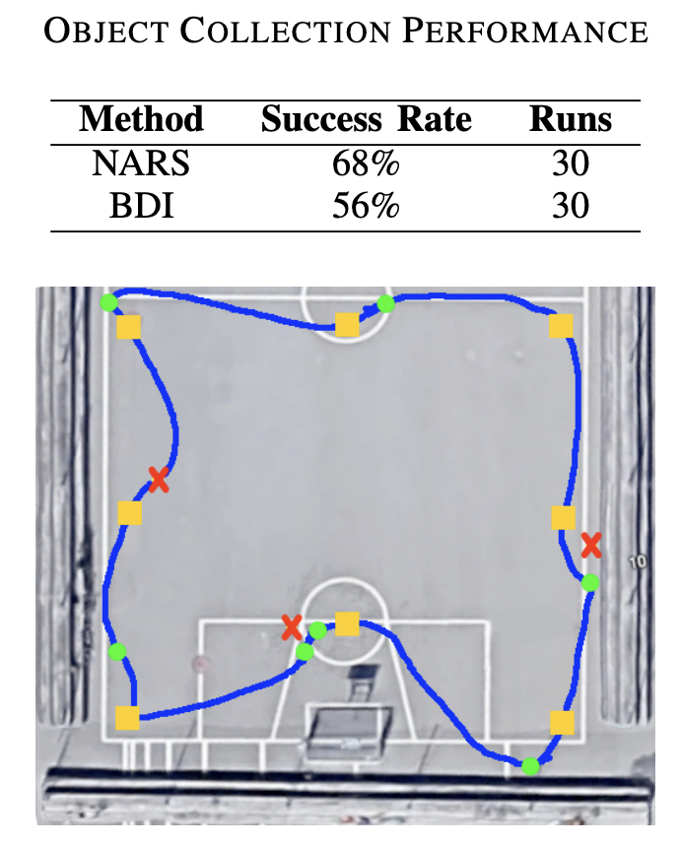
RESULTS
Overall task performance across 50 runs is 68% (of collected garbage items)
Belief-Desire-Intention model baseline performs at 56%
Helpful hypotheses maintained at runtime such as system-built hypotheses that record success of picking individual objects:
<(<{instanceX} --> [see]> &/ ^pick) =/> <gripper --> [hold]>>
System built expectations about presence of trash objects at different places such as:
<<({SELF} * {Pi}) --> at> =/> <trash --> [see]>>.
Potential future work: use for route optimization…

Slide 26
II. NACE (Non-Axiomatic Causal Explorer)

Slide 27
INTRODUCTION
Experiential Learning
Learning from observation
Incremental and interactive learning
No high-level semantic encoding
Main Features
Utilizes logical causal relation induction from observation using NAL aspects
Empirical-causal relations capturing transitions between parts of states, not full transitions between states
Planning for future states of maximum uncertainty for data-efficient exploration

Slide 28
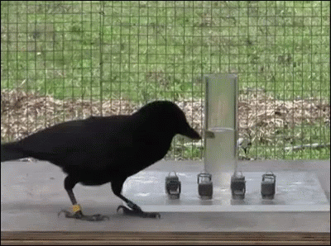
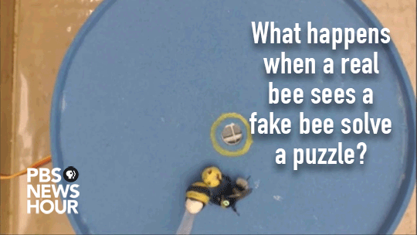
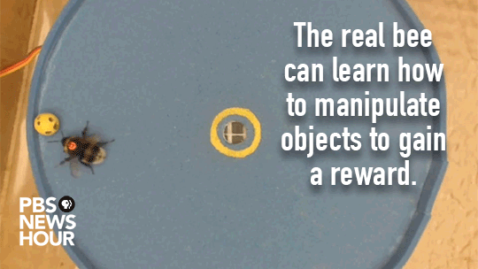
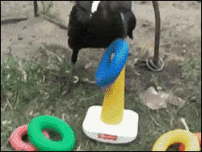
CAUSAL REASONING IN NATURE…
Evidence for causal reasoning between species varies
Corvids, dolphins, elephants, great apes:
long-horizon planning abilities with profound
causal knowledge and ability to acquire new one
Bumblebee: too early to say, maybe “just” a form of imitation learning?

Slide 29
SPATIAL MEMORY & CURIOSITY
Experiential Learning
Incremental and interactive learning
Consider changes and prediction mismatches in hypothesis induction
Keep track of locations of observations
Main Features
Utilizes logical causal relation induction from observation using NAL
Causal relations capturing transitions between parts of states, not full transitions between states
Planning for future states of maximum uncertainty for data-efficient exploration

Slide 30
ARCHITECHTURE
NACE
Data-efficient hypothesis induction
Driven by curiosity and uncertainty
Explicit spatial memory
Long-horizon causal planning
Iterative emerging behavior
Observer
Registers changes
Finds mismatches
Actual World
Hypothesize
Creation
Revision
Choice
Planner
Score increase
$${min(P}_{w})<1$$
Babbling
Predictor
Calcs $P$-match
Makes Prediction based on action

Slide 31
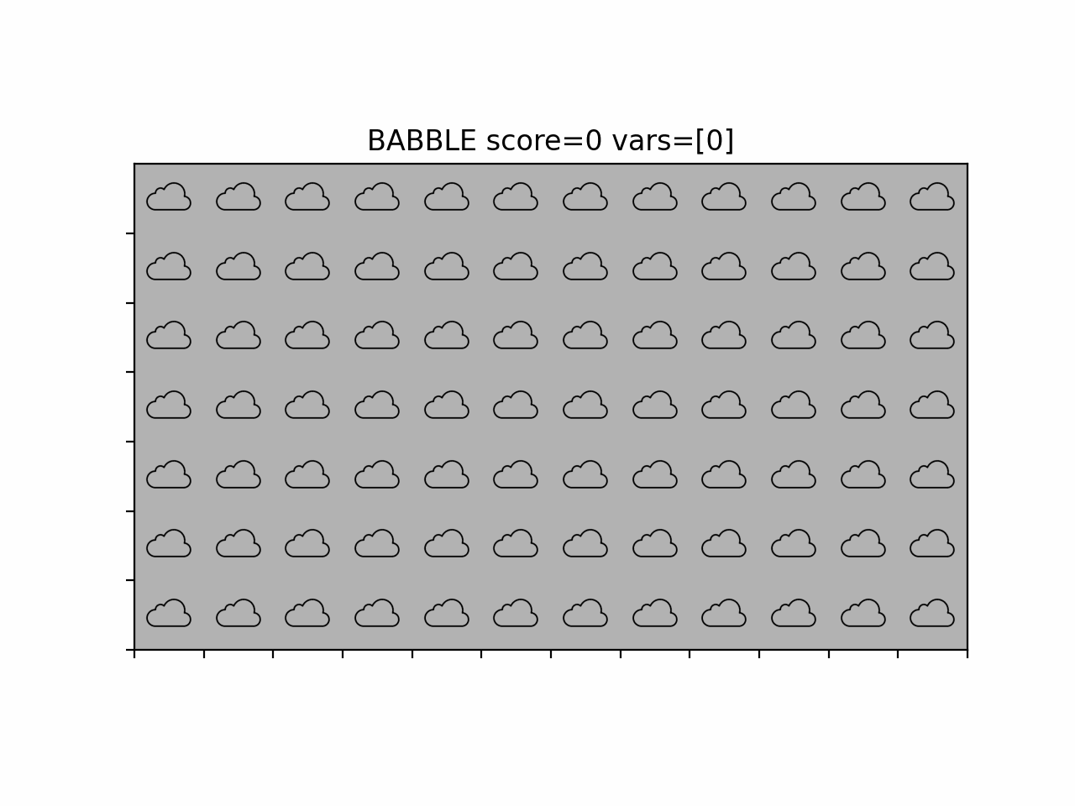
REAL-TIME SINGLE-EPISODE LEARNING DEMO

Slide 32
INDUCTIVE BIASES
Temporal Locality
Ability to model relevant dependencies locally in time, in simplest case just involving prior simulation frame.
Causal Representation
Ability to model causal dependencies independently of acquired reward, making the model able to learn beliefs of the environment that can be chained and are agnostic to its objective.
Spatial Equivariance
Ability to model causal dependencies between grid cells independently of the specific location of the cells considered in the dependency.
State Tracking
Ability to effectively track state outside of the field of view of the agent based on the recorded or estimated locations.
Attentional Bias
Relevant dependencies tend to involve values that have either changed or a different value than predicted (miss-matched)

Slide 33
P-MATCH FOR CURIOSITY AND EXLORATION
Rule P-match of certain cell:
$$P_{r}^{c}=\frac{matchedconditions}{totalconditions}$$
Cell P-match:
$$P_{c}=\max\left(P_{r}^{c1}…P_{r}^{cn}\right)$$
World P-match:
$$P_{w}=max⁡(P_{c}^{1,1}…P_{c}^{n,m})$$
Planner selection criteria:
$$P_{w}=\min\left(P_{w}^{1}…P_{w}^{n}\right)$$
$$P_{w}<1$$

Slide 34
SHORT DEMO
Operations:
Actual World
Explorer 1
||| | ||| | ||| | ||| | ||| | ||| | |||
||| |  |  |  |  |  | |||
||| |  |  | X | III |  | |||
||| | ||| | ||| | ||| | ||| | ||| | |||
Observer
Registers changes
Finds mismatches
Rules:
$w^{+}w^{−}w^{T}$
R1: <(0,0 = ‘x’, 1,0 = ‘III’, ^right) ==> (0,0 = ‘x’)> 1 0 1
R2: <(-1 = ‘x’, 0 = ‘’, ^right) ==> (0 = ‘x’)> 1 0 1
…
Hypothesize
Creation
Revision
Choice
Imaginary Worlds:
Mental World
||| | ||| | ||| | ||| | ||| | ||| | |||
||| |  |  |  |  |  | |||
||| | X | X |  |  |  | |||
||| | ||| | ||| | ||| | ||| | ||| | |||
1’ | 1’ | 1’ | 1’ | 1’ | 1’ | 1’
1’ | 1’ | 1’ | 1’ | 1’ | 1’ | 1’
1’ | 1’ | 1’ | 1’ | 1’ | 1’ | 1’
1’ | 1’ | 1’ | 1’ | 1’ | 1’ | 1’
1’ | 1’ | 1’ | 1’ | 1’ | 1’ | 1’
0.5 | 0.5 | 0.5 | 0.5 | 0.5 | 0.5 | 1’
0.5 | 0.5 | 1, ‘’ | 1, X | 0.5 | 0.5 | 1’
1’ | 1’ | 1’ | 1’ | 1’ | 1’ | 1’
Planner
Score increase
$$P_{w}<1$$
Babbling
…
Predicted World ($P_{w}<1$)
1’ | 1’ | 1’ | 1’ | 1’ | 1’ | 1’
1’ | 1’ | 1’ | 1’ | 1’ | 1’ | 1’
1’ | 1’ | 1’ | 1’ | 1’ | 1’ | 1’
1’ | 1’ | 1’ | 1’ | 1’ | 1’ | 1’
1’ | 1’ | 1’ | 1’ | 1’ | 1’ | 1’
0.5 | 0.5 | 0.5 | 0.5 | 0.5 | 0.5 | 1’
0.5 | 0.5 | 0.5 | 1, ‘’ | 1, X | 0.5 | 1’
1’ | 1’ | 1’ | 1’ | 1’ | 1’ | 1’
||| | ||| | ||| | ||| | ||| | ||| | |||
||| |  |  |  |  |  | |||
||| |  |  | X |  |  | |||
||| | ||| | ||| | ||| | ||| | ||| | |||
…
Predictor
Calcs $P$-match
Makes Predictions based on action
1’ | 1’ | 1’ | 1’ | 1’ | 1’ | 1’
1’ | 1’ | 1’ | 1’ | 1’ | 1’ | 1’
1’ | 1’ | 1’ | 1’ | 1’ | 1’ | 1’
1’ | 1’ | 1’ | 1’ | 1’ | 1’ | 1’
1’ | 1’ | 1’ | 1’ | 1’ | 1’ | 1’
0.5 | 0.5 | 0.5 | 0.5 | 0.5 | 0.5 | 1’
0.5 | 0.5 | 0.5 | 0.5 | 1, ‘’ | 1, X | 1’
1’ | 1’ | 1’ | 1’ | 1’ | 1’ | 1’
…
1’ | 1’ | 1’ | 1’ | 1’ | 1’ | 1’
1’ | 1’ | 1’ | 1’ | 1’ | 1’ | 1’
1’ | 1’ | 1’ | 1’ | 1’ | 1’ | 1’
1’ | 1’ | 1’ | 1’ | 1’ | 1’ | 1’
1’ | 1’ | 1’ | 1’ | 1’ | 1’ | 1’
0.5 | 0.5 | 0.5 | 0.5 | 0.5 | 0.5 | 1’
0.5 | 0.5 | 0.5 | 0.5 | 0.5 | 0.5 | 1’
1’ | 1’ | 1’ | 1’ | 1’ | 1’ | 1’

Slide 35
UNCERTAINTY ESTIMATION
Revision
Collects the $w^{+}$ and $w^{−}$evidence experienced so far
Revises rules which allowed for valid prediction and/or mismatch
Choice
Makes certain rules invisible for the planner
Given rules with same pre-conditions selects the highest truth expectation
$w^{+}w^{−}w^{T}$
R1: <(0 = ‘x’, 1 = ‘’, ^right) ==> (0 = ‘’)> 2 1 3
R2: <(-1 = ‘x’, 0 = ‘’, ^right) ==> (0 = ‘x’)> 2 1 3
R3: <(0 = ‘x’, 1 = ‘|||’, ^right) ==> (0 = ‘x’)> 1 0 1
R4: <(-1 = ‘x’, 0 = ‘|||’, ^right) ==> (0 = ‘|||’)> 1 0 1
R5: <(0 = ‘x’, 1 = ‘’, ^right) ==> (0 = ‘x’)> 1 0 1
R6: <(-1 = ‘x’, 0 = ‘’, ^right) ==> (0 = ‘’)> 1 0 1

Slide 36
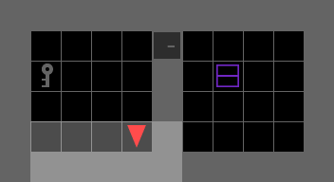
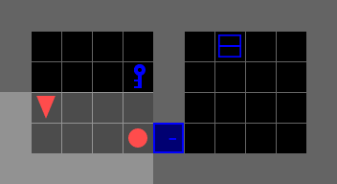
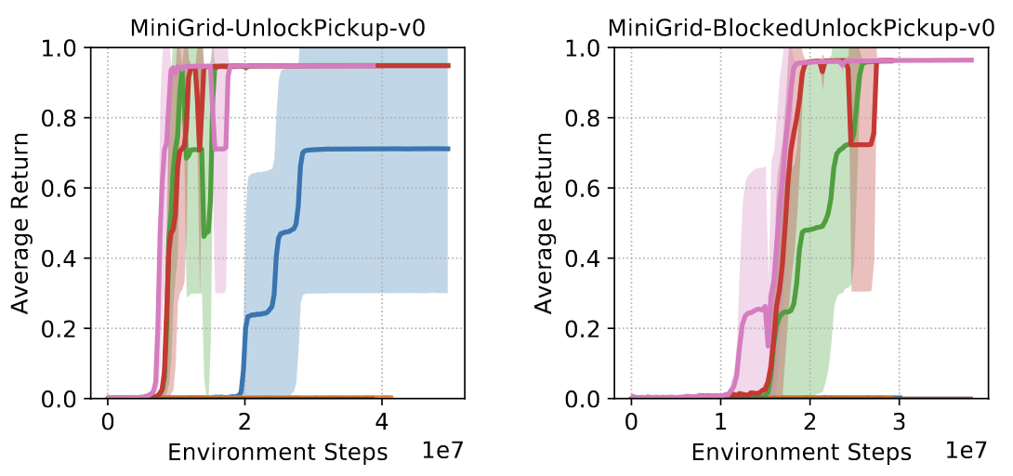
QUANTATIVE RESULTS IN MINIGRID (Gym-Minigrid)
MiniGrid-UnlockPickup | SOTA methods | NACE
Learning steps till avg. return > 0.8 | 8 Million | 300
MiniGrid-BlockedUnlockPickup-v0 | SOTA methods | NACE
Learning steps till avg. return > 0.8 | 15 Million | 400

Slide 37
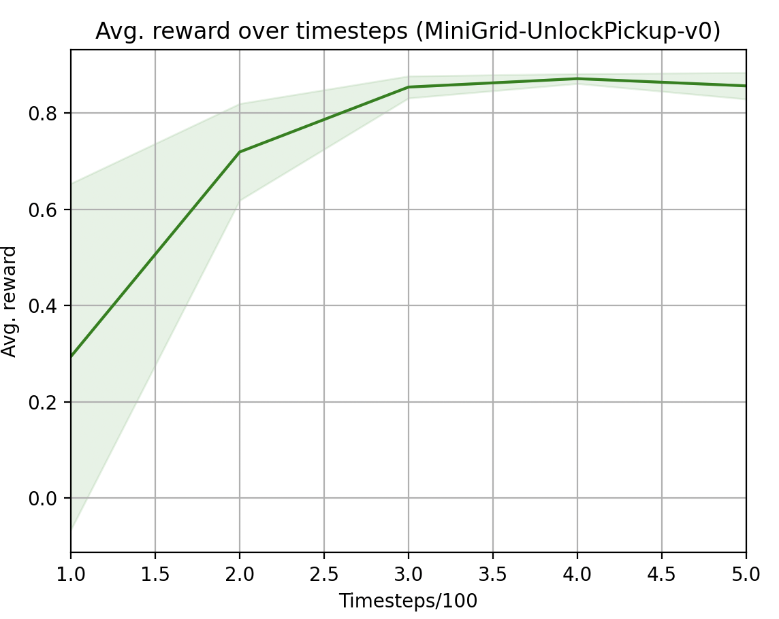
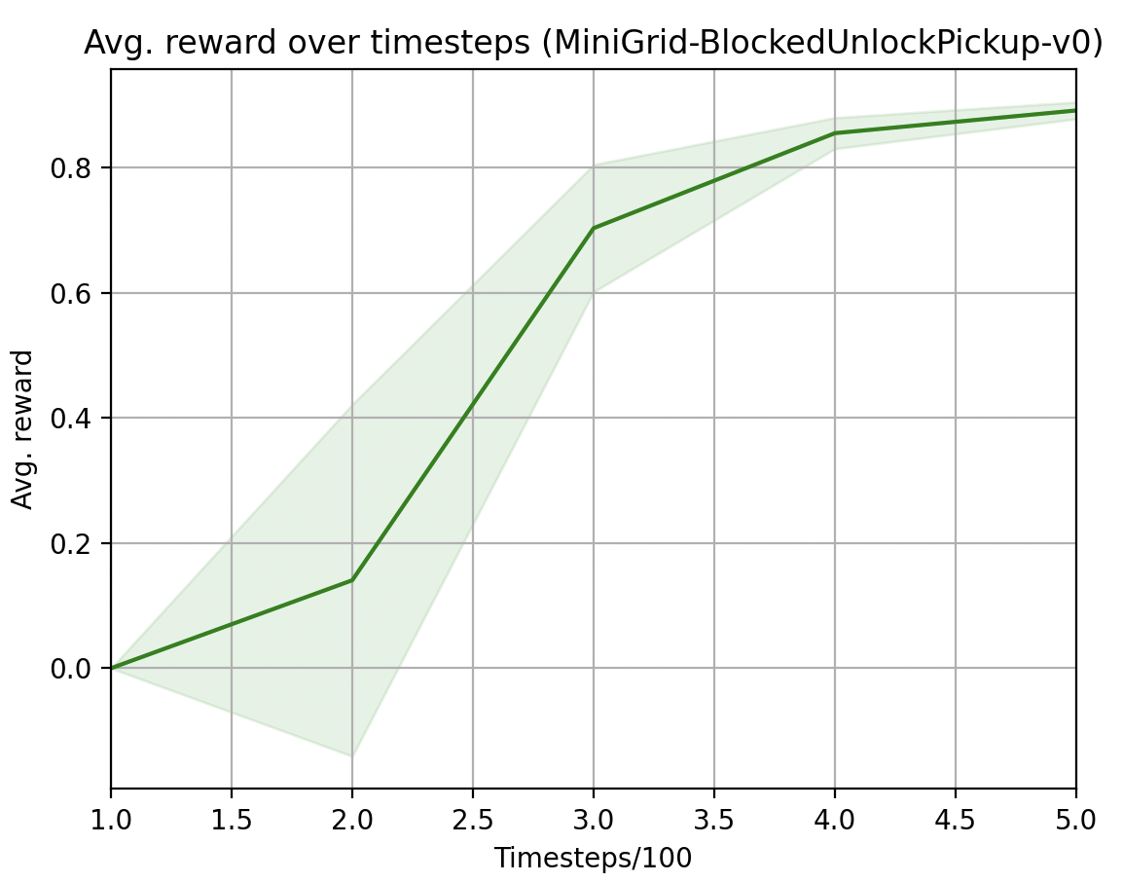
QUANTATIVE RESULTS IN MINIGRID (Gym-Minigrid)
MiniGrid-UnlockPickup | SOTA methods | NACE
Learning steps till avg. return > 0.8 | 8 Million | 300
MiniGrid-BlockedUnlockPickup-v0 | SOTA methods | NACE
Learning steps till avg. return > 0.8 | 15 Million | 400

Slide 38
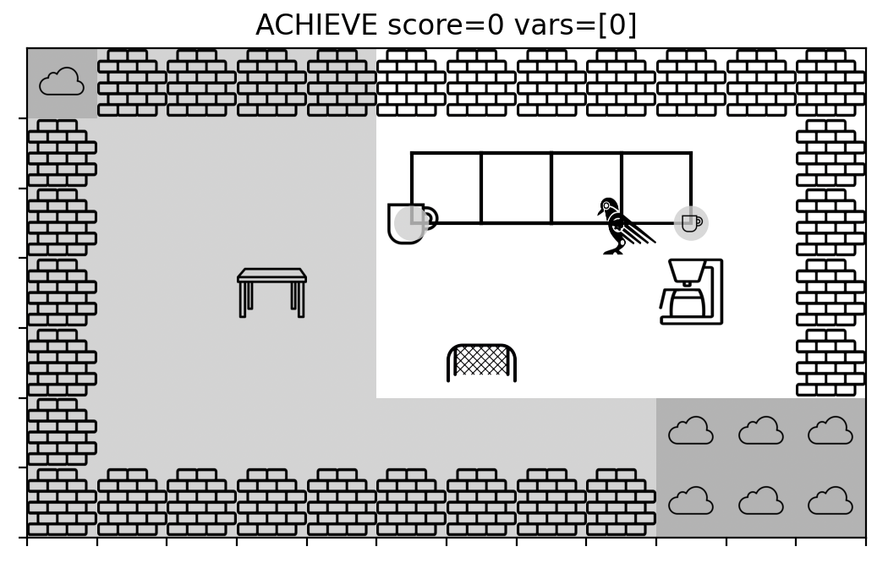
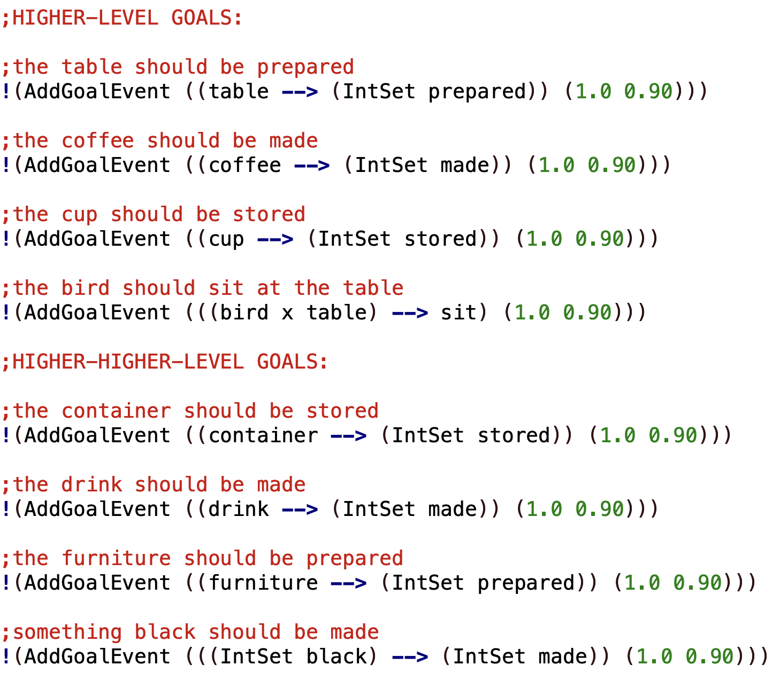
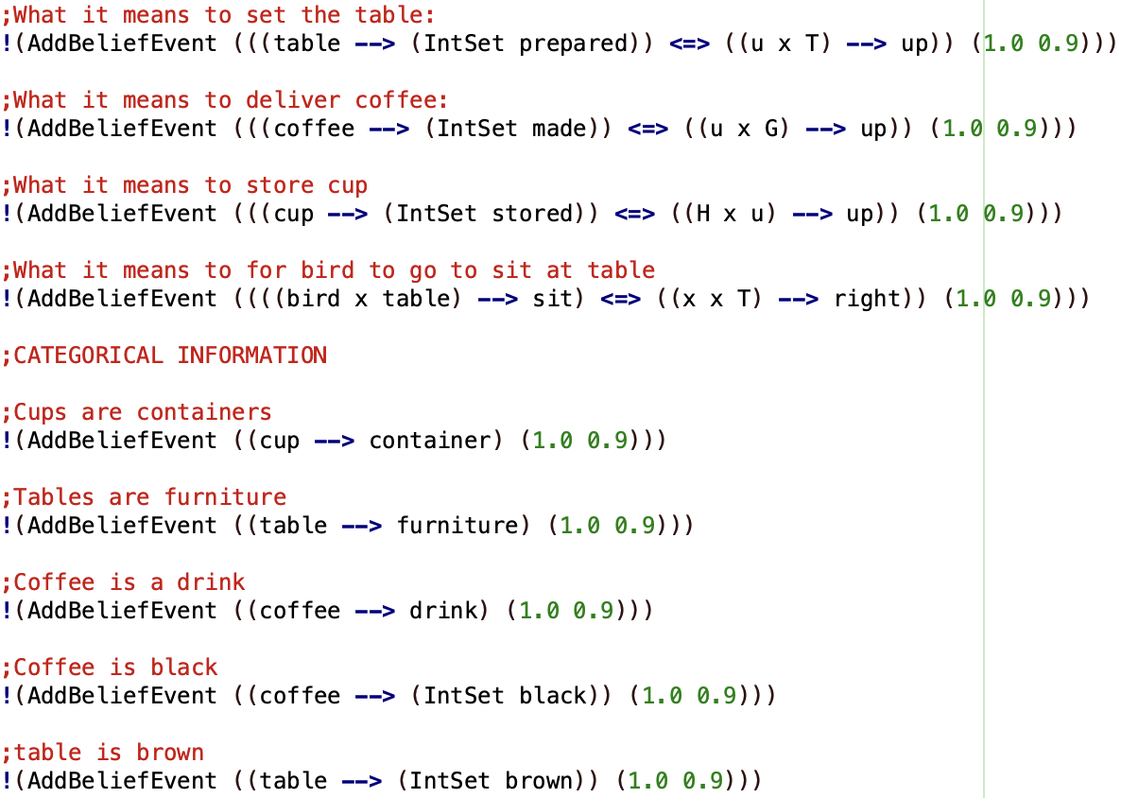
NARS & NACE HYBRID
Experiential Learning
Use NARS for high-level reasoning
Use NACE as a sensorimotor subsystem
Example goals and knowledge

Slide 39
CONCLUSION
NARS
Learning from interactions such as in RL environments
Conditioning on relations is possible (shape picking)
Applicable for mobile robots as shown
NACE
Specialized grid world NARS with curiosity model
Highly data-efficient
Can be combined with or extended to full NARS
Roadmap
Combine our best principles in a next-generation NARS implementation

Slide 40
THANK YOU!

